Slide 1
Separation Techniques
Physical Methods that will separate the components of Mixtures

Slide 2
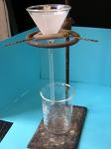
FILTRATION
PASSING A CLOUDY LIQUID THROUGH A FILTER TO RETAIN THE SOLID AND LET THE LIQUID PASS.
Filtration Hyperlink

Slide 3
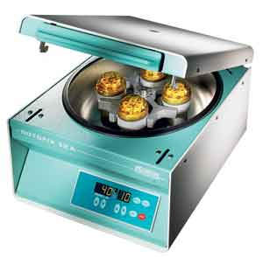
CENTRIFUGING
USING CENTRIFUGAL FORCE TO PACK SOLID PARTICLES TO THE BOTTOM OF A TUBE.
Centrifuging hyperlink

Slide 4
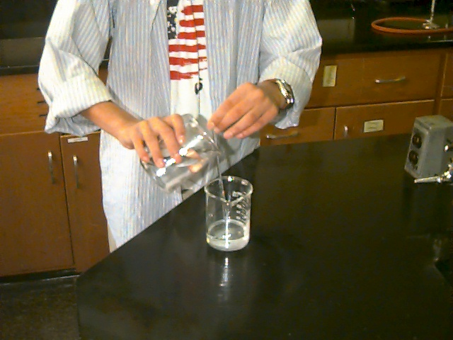
DECANTING
POURING OFF THE LIQUID FROM THE TOP AND RETAINING THE SOLID ON THE BOTTOM.
Decanting Hyperlink

Slide 5
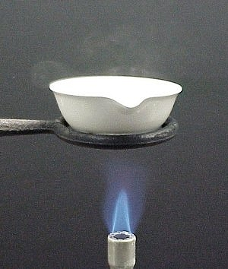
EVAPORATION
CHANGING THE LIQUID TO A GAS USING HEAT, WHILE RETAINING THE SOLID.
Evaporation Hyperlink

Slide 6
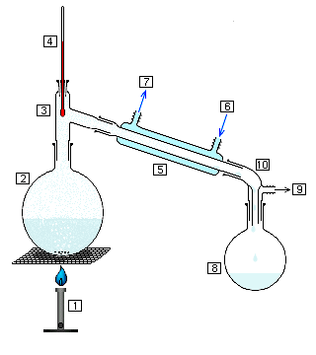
DISTILLATION
BASED ON DIFFERENCES IN BOILING POINTS, TWO LIQUIDS CAN BE SEPARATED WHEN ONE CHANGES TO A GAS AND THE OTHER REMAINS LIQUID.
Distillation Hyperlink

Slide 7
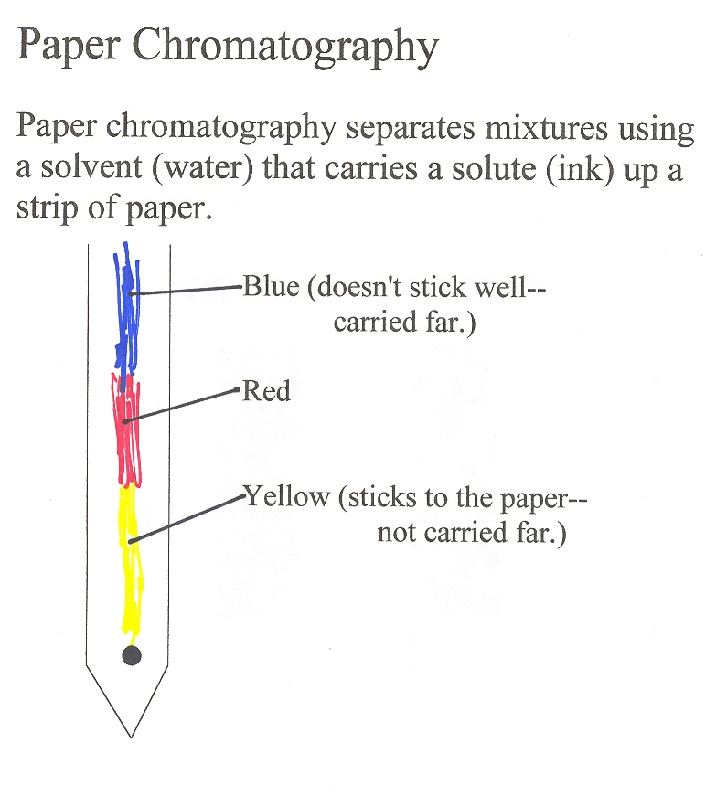
CHROMOTOGRAPHY
Chromatography Hyperlink

